Slide 1
IBPSES
CT104-3-2-VD1
INTRODUCTION TO GBI
Prepared by: NKN First Prepared on: 01.01.12 Last Modified on: 01.02.18
Quality checked by: SKS
Copyright 2012 Asia Pacific University of Technology and Innovation

Slide 2
Course Overview
Introduction to SAP
Navigation
Introduction to GBI
Sales & Distribution
Materials Management
Production Planning
Financial Accounting
Controlling
Human Capital Management
Warehouse Management
Project System

Slide 3
Unit Overview
Global Bike Group
Organizational Structure
Products
Business Partners
Business Processes

Slide 4
Global Bike Group
Background:
Global concern using full ERP capabilities
Consists of two companies located in the US and in Germany
History:
John Davis won numerous mountain bike championships in the US
In 1990, started his own mountain bike company (Frankenstein Bikes)
Peter Schwarz grew up on road bikes in the Black Forest, Germany
As a student, he engineered ultra-light composite frames
In 1993, started his own bike frame company (Heidelberg Composites)
Both met in 2000
In 2001, merged to form Global Bike Inc.

Slide 5
Global Bike Group
Strategy:
John and Peter are Co-CEOs
John is responsible for (in terms of reporting)
Sales, Marketing, Service and Support, IT, Finance, and Human Resources
sells products and brings in money
Peter is responsible for
Research, Design, Procurement, and Manufacturing Groups
builds products and spends money
World-class bicycle company serving both the professional and “prosumer” in touring and off-road racing.
Focus on:
Quality
Toughness
Performance

Slide 6
Organizational Structure (Overview)
Global Bike Group
Concern
Co-CEO John Davis
Co-CEO Peter Schwarz
Global Bike Inc.
Global Bike Germany GmbH
Companies
Dallas
Miami
San Diego
Heidelberg
Hamburg
Locations

Slide 7
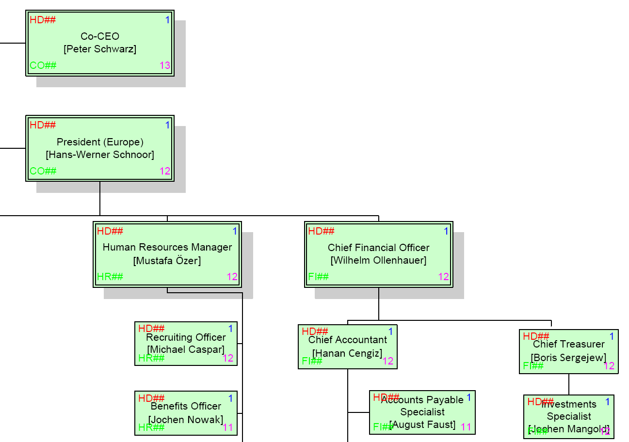
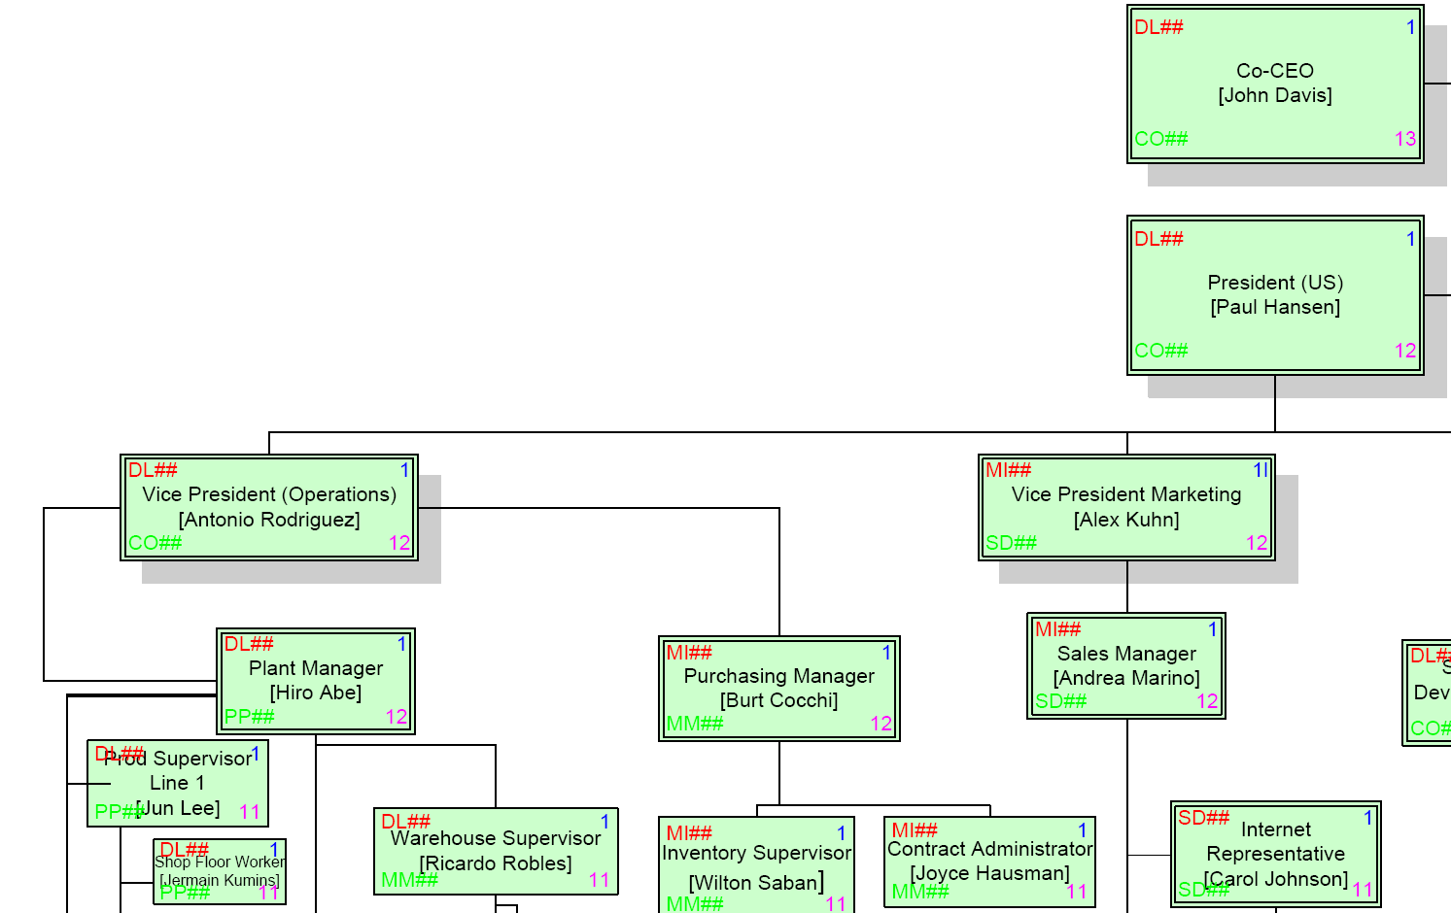
Organizational Structure (Human Resources)
Employees (US and Germany)

Slide 8
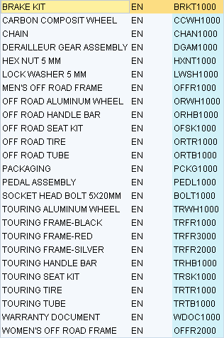
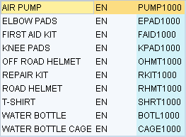
Products
Trading Goods
Accessories
Safety Gear
Other
Raw Materials

Slide 9

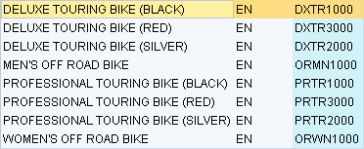
Products
Semi-Finished Goods
Finished Goods
Touring Bikes (Deluxe, Professional) in three colors
Off-Road Bikes (Men, Women)

Slide 10
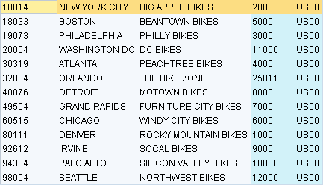
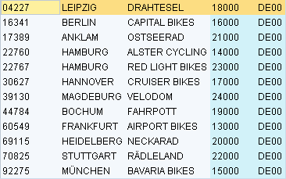
Business Partners
Customers (US and Germany)

Slide 11
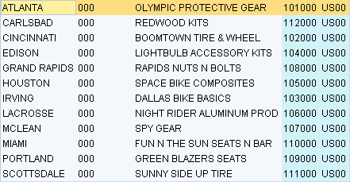
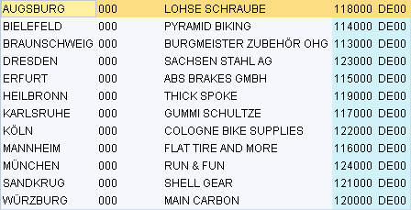
Business Partners
Vendors (US and Germany)

Slide 12
Business Processes
Sell – Fulfillment
Buy – Procurement
Make – Production
Track – Financial Accounting
Track – Controlling
People – Human Capital Management
Store – Inventory and Warehouse Management
Plan – Material Planning
Maintain – Enterprise Asset Management
Service – Customer Service
Project – Project Management

Slide 13
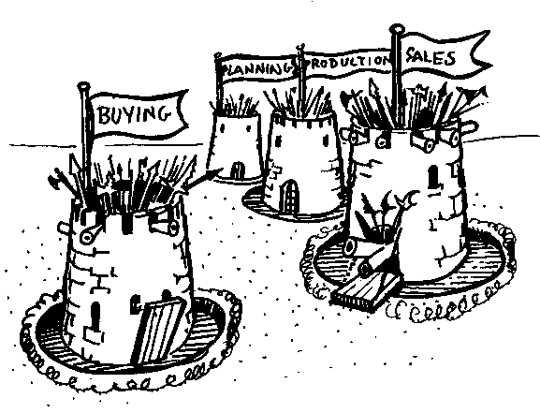
Cross-functional Integration
Source Unknown
Notes:
ERP - Enterprise Resource Planning - breaks down the traditional barrier that exist within a corporation. For anyone to benefit from ERP, everyone has to contribute, this is the key to ERP survival.
There has to be a common agenda throughout the business. To get the commitment from everyone, everyone has to believe their needs and objectives are addressed by the plan, learning the tools and techniques to accomplish this is then relatively easy.

Slide 14
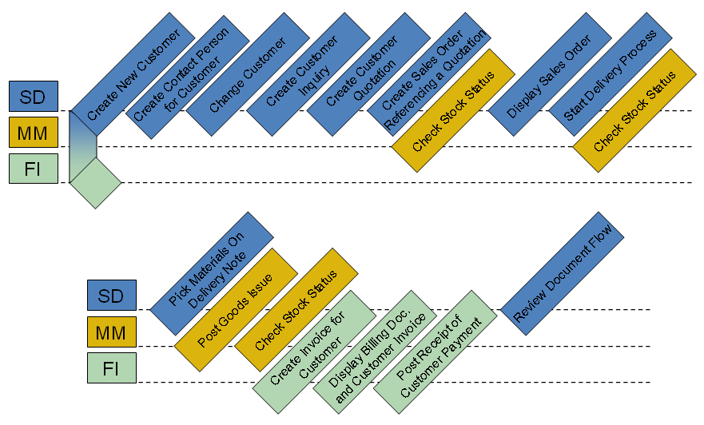
Process Integration
Order-to-Cash Process
Sales and Distribution (SD)
Materials Management (MM)
Financial Accounting (FI)

Slide 15
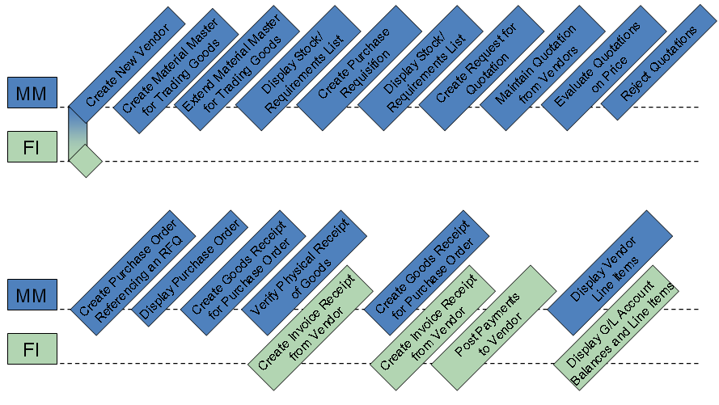
Process Integration
Procure-to-Cash Process
Materials Management (MM)
Financial Accounting (FI)

Slide 16
Question and Answer Session
Q & A

Slide 17
What we will cover next
SAP GUI navigation
Fulfillment

